Slide 1
16. Attention & Transformer
罗志明
zhiming.luo@xmu.edu.cn

Slide 2
提纲
Attention
Transformer

Slide 3
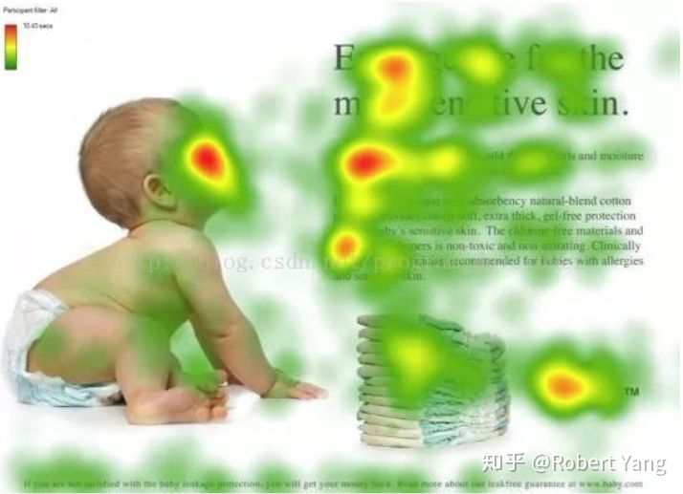
Attention
人类视觉的注意力机制
重点关注有信息的区域
提高效率与准确率

Slide 4
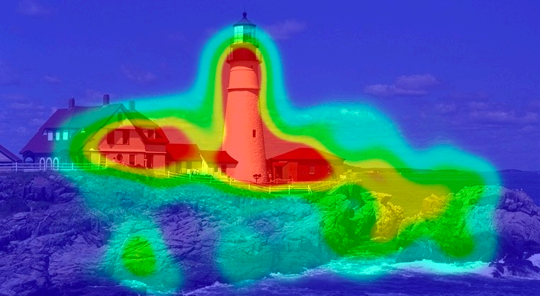
Attention
分类模型中的Attention
如何计算出对正确分类最重要的图像区域？

Slide 5
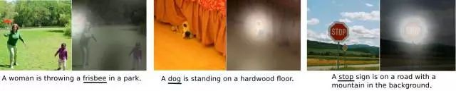
Attention
Hard-attention 与 Soft-attention
Cross-attention 与 Self-attention

Slide 6
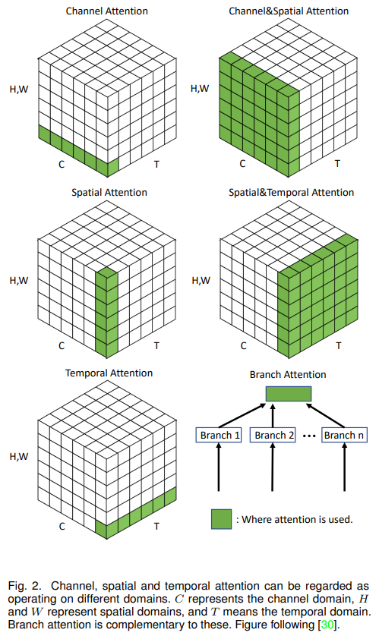
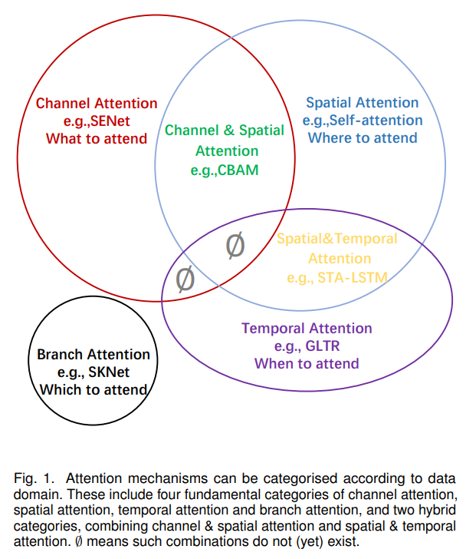
Attention
Attention Mechanisms in Computer Vision: A Survey

Slide 7
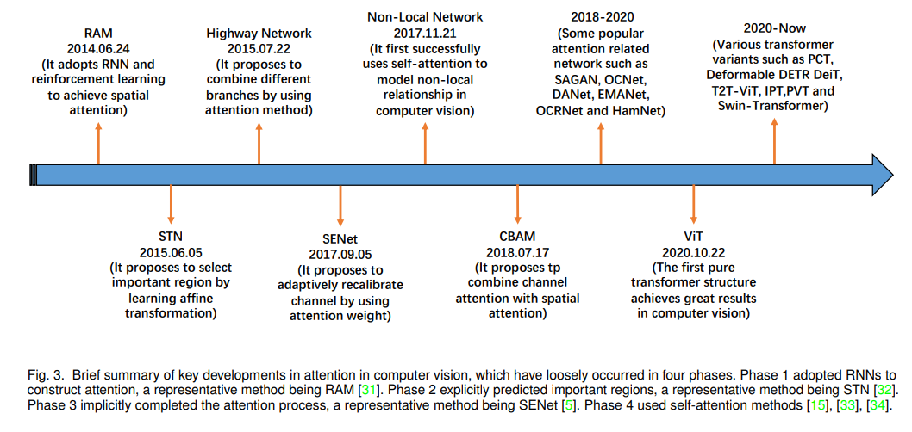
Attention
Attention Mechanisms in Computer Vision: A Survey

Slide 8
Attention
Attention Mechanisms in Computer Vision: A Survey

Slide 9
Attention
Channel-wise
Spatial-wise

Slide 10
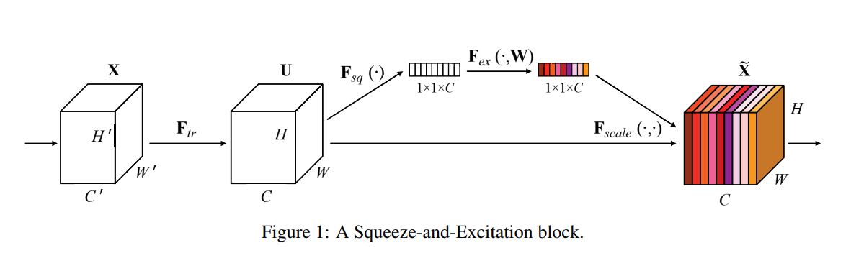
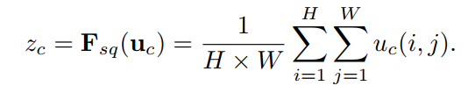


Squeeze-and-Excitation
In earlier layers, it excites informative features in a class-agnostic manner, strengthening the shared low-level representations.
In later layers, the SE blocks become increasingly specialized, and respond to different inputs in a highly class-specific manner.
As a consequence, the benefits of the feature recalibration performed by SE blocks can be accumulated through the network.
Hu et al. Squeeze-and-Excitation Networks. CVPR 2018.

Slide 11
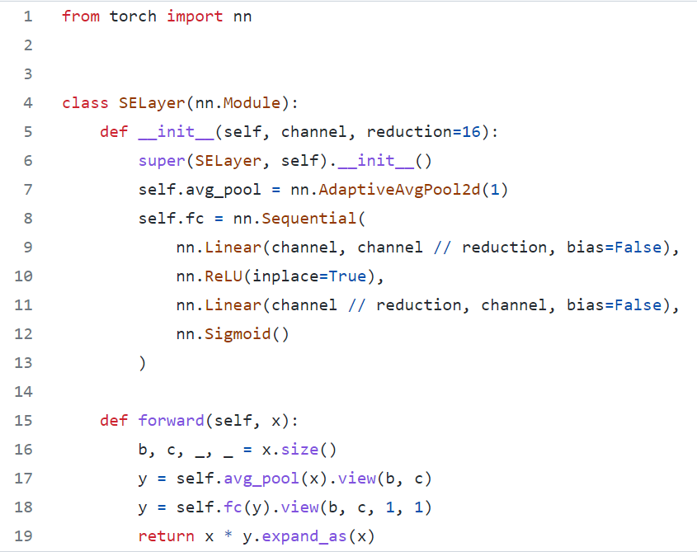
Squeeze-and-Excitation

Slide 12
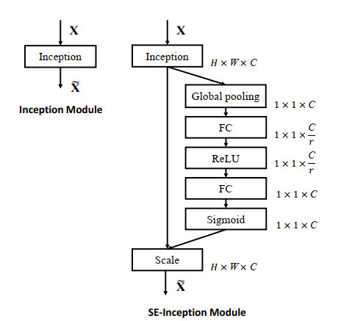
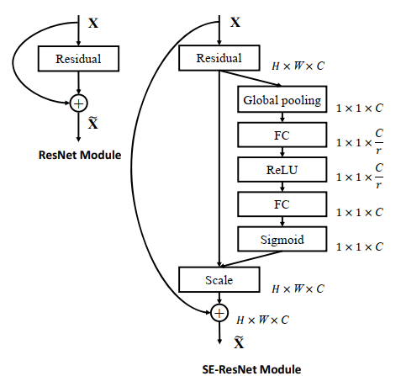
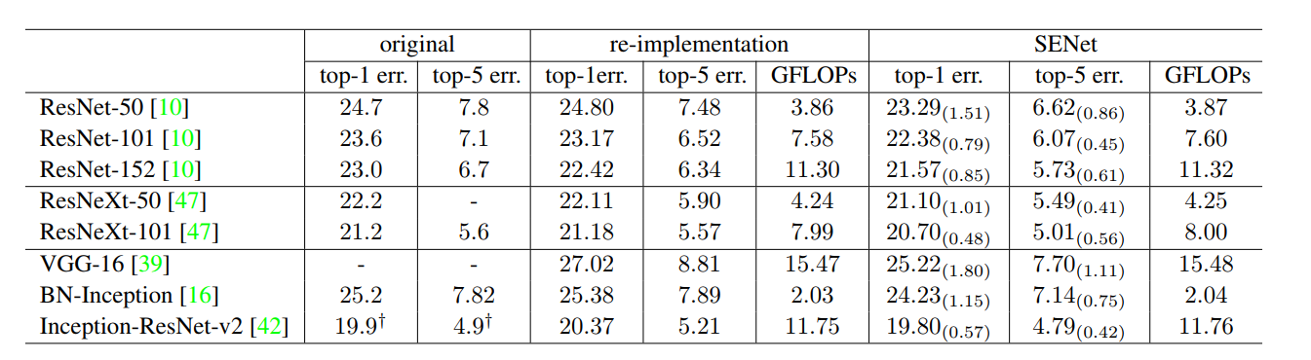
Squeeze-and-Excitation
GFLOPS 就是 Giga Floating-point Operations Per Second，即每秒10亿次的浮点运算数。
1GFlops = 1,000MFlops
https://github.com/Lyken17/pytorch-OpCounter
Hu et al. Squeeze-and-Excitation Networks. CVPR 2018.

Slide 13
Spatial-wise
Spatial Transformer Networks
CBAM: Convolutional Block Attention Module

Slide 14
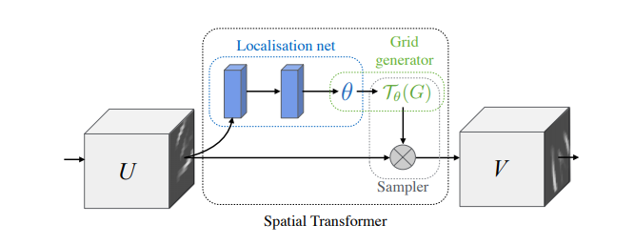
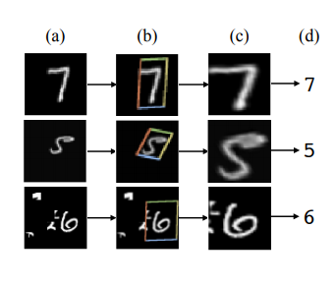
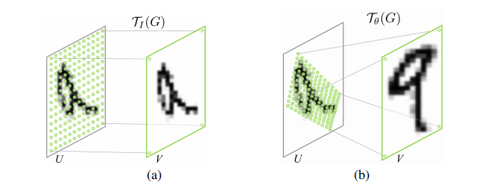
Spatial Transformer Networks
Jaderberg et al. Spatial Transformer Networks. NeurIPS 2015.

Slide 15
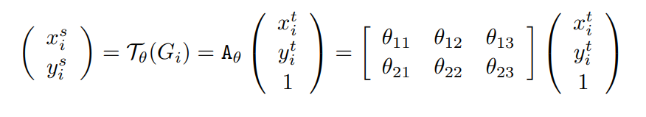
Spatial Transformer Networks
2D Affine Transformation

Slide 16
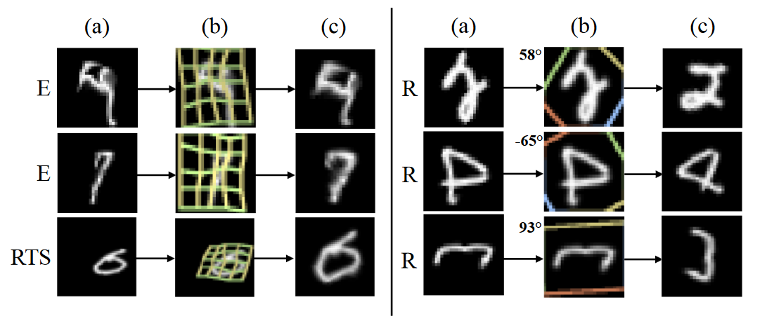
STN results

Slide 17
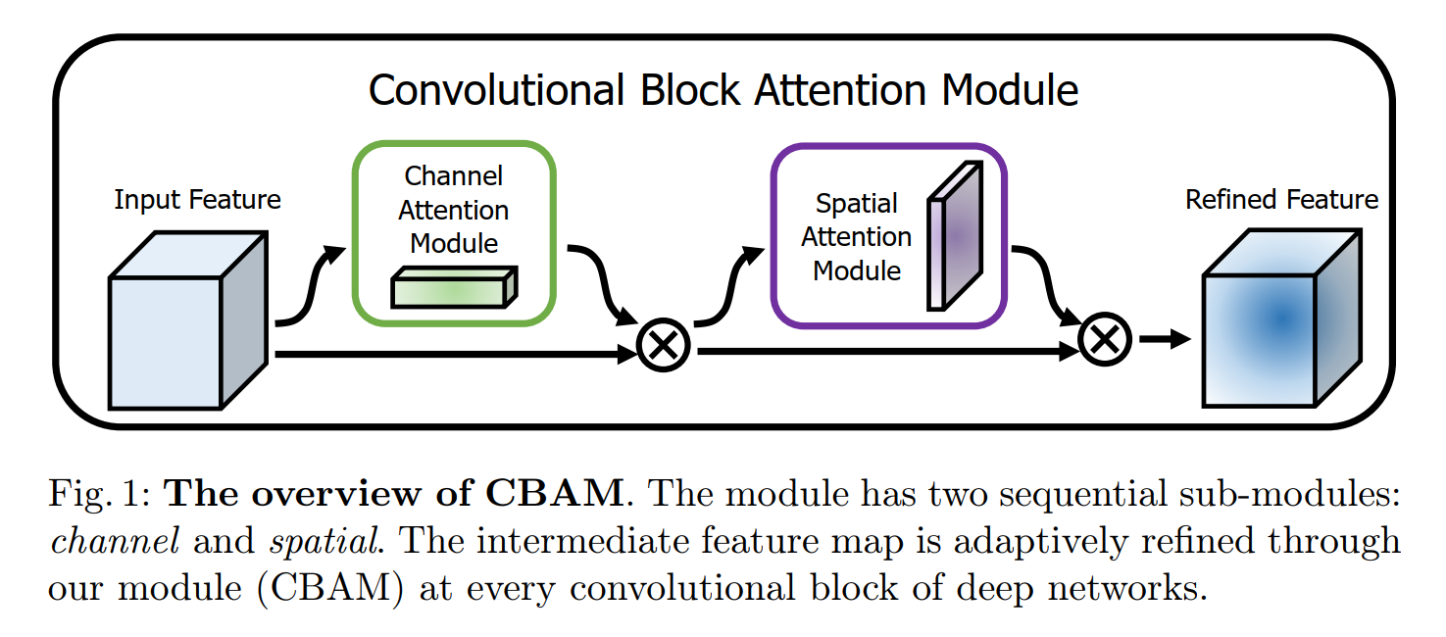
CBAM: Convolutional Block Attention Module
“what”: channel-wise
“where”: spatial-wise
Woo et al. CBAM: Convolutional Block Attention Module. ECCV 2018.

Slide 18
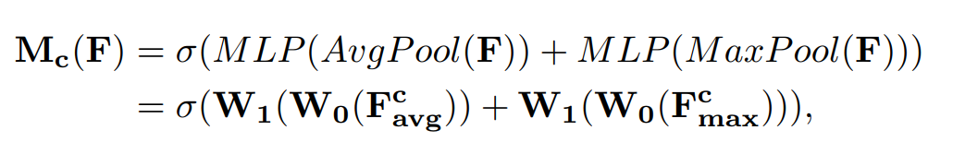
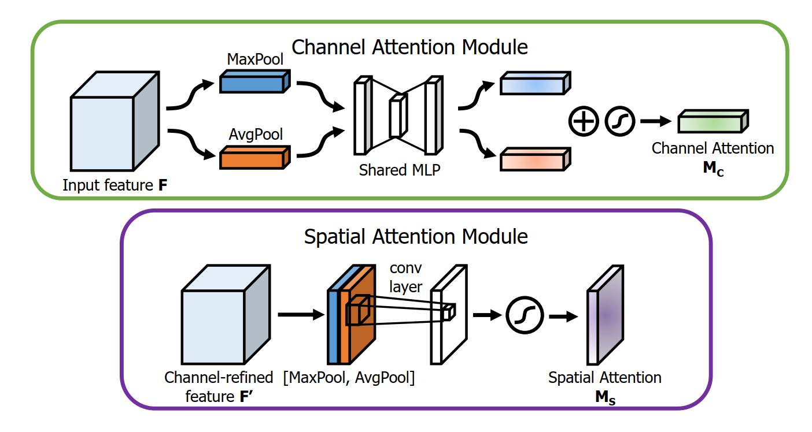
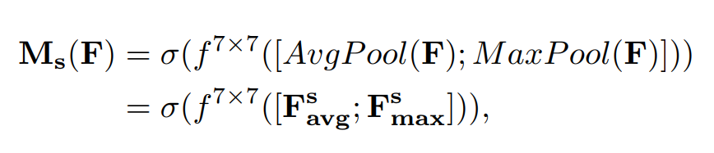
CBAM: Convolutional Block Attention Module
Channel Attention Module
Spatial Attention Module
Woo et al. CBAM: Convolutional Block Attention Module. ECCV 2018.

Slide 19
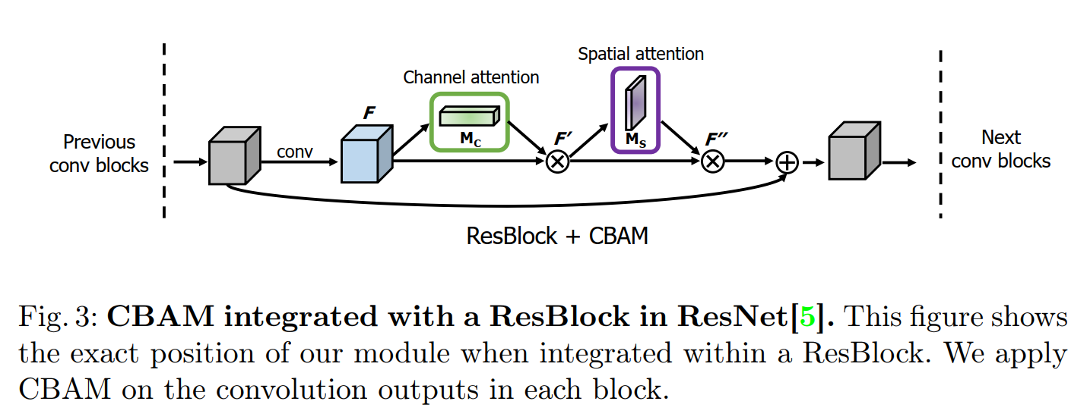
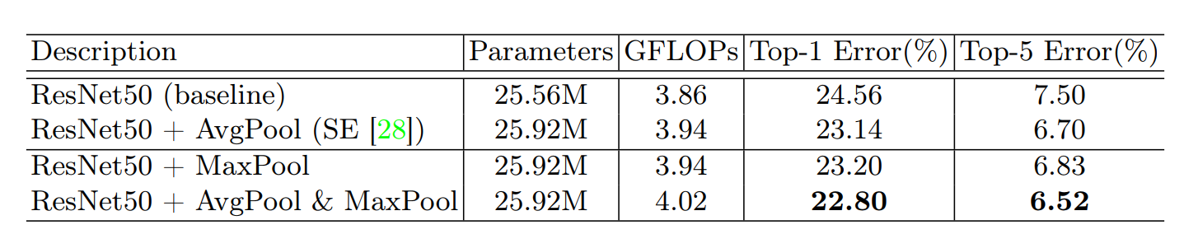
CBAM: Convolutional Block Attention Module
Woo et al. CBAM: Convolutional Block Attention Module. ECCV 2018.

Slide 20
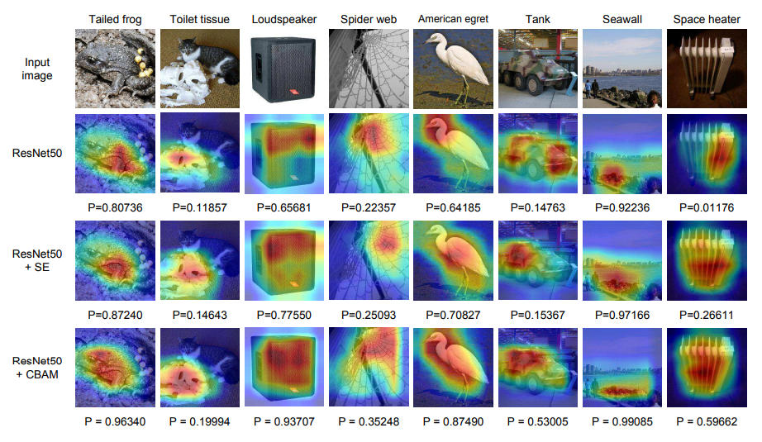
CBAM: Convolutional Block Attention Module
Woo et al. CBAM: Convolutional Block Attention Module. ECCV 2018.

Slide 21
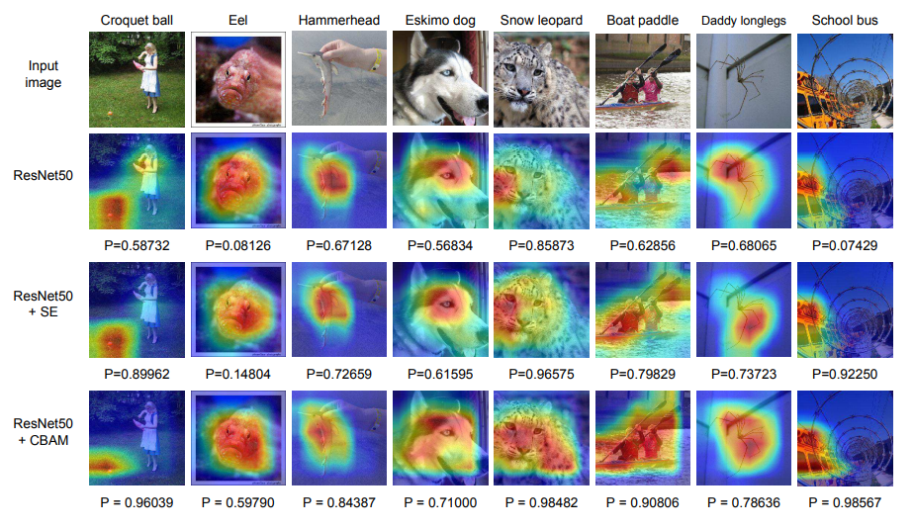
CBAM: Convolutional Block Attention Module
Woo et al. CBAM: Convolutional Block Attention Module. ECCV 2018.

Slide 22
提纲
Attention
Transformer

Slide 23
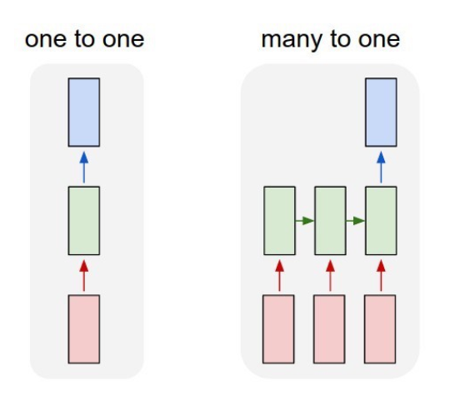
Recurrent Neural Network
FC Nets与ConvNets存在的局限性：
固定的输入大小 (例: 224*244图片)
固定的输出大小 (例: 预测的类别概率)
RNNs更适合用于处理序列输入数据(例：文本、语言、时序数据)

Slide 24
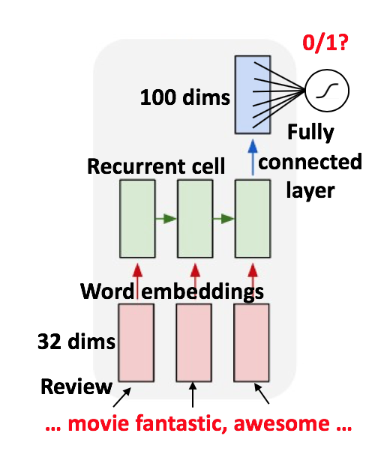



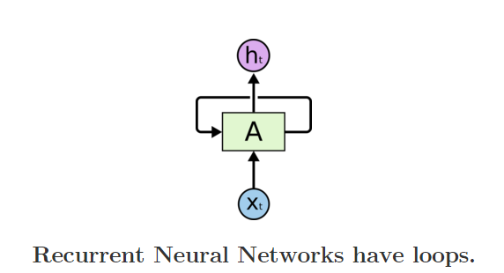

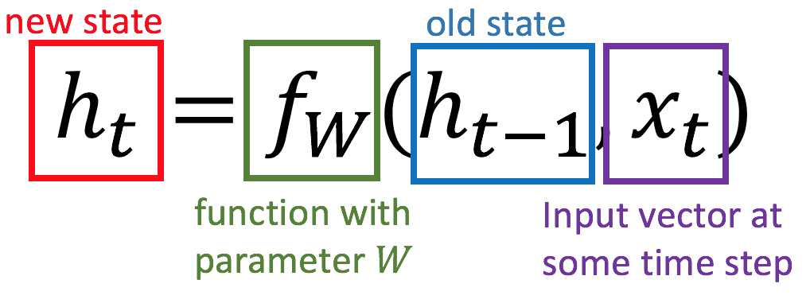
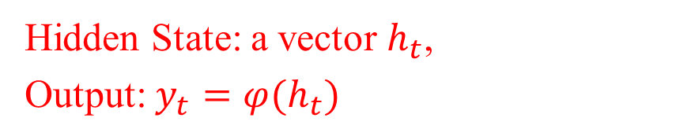
Recurrent Neural Network
Recurrent Neural Network带有环(loop)的神经网络, 用于存储序列信息。
Hidden State: a vector $h_{t}$,
Output: $y_{t}=φ(h_{t})$

Slide 25
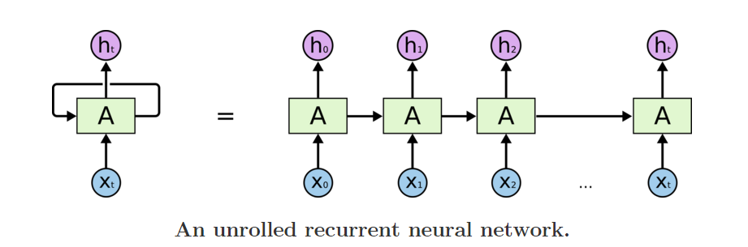
Recurrent Neural Networks
RNN可以展开成序列模型：

Slide 26
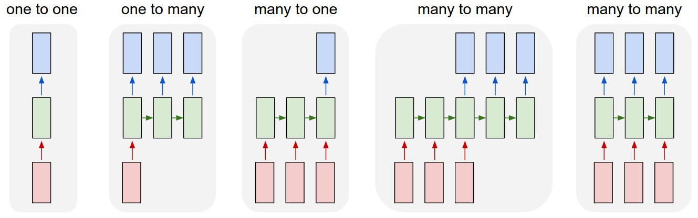
Sequence Learning with One RNN Layer
1
2
3
4
5
Standard NN mode without recurrent structure (e.g. image classification, one label for one image).
Sequence output (e.g. image captioning, takes an image and outputs a sentence of words).
Sequence input (e.g. sentiment analysis, a sentence is classified as expressing positive or negative sentiment).
Sequence input and sequence output (e.g. machine translation, a sentence in English is translated into a sentence in French).
Synced sequence input and output (e.g. video classification, label each frame of the video).

Slide 27
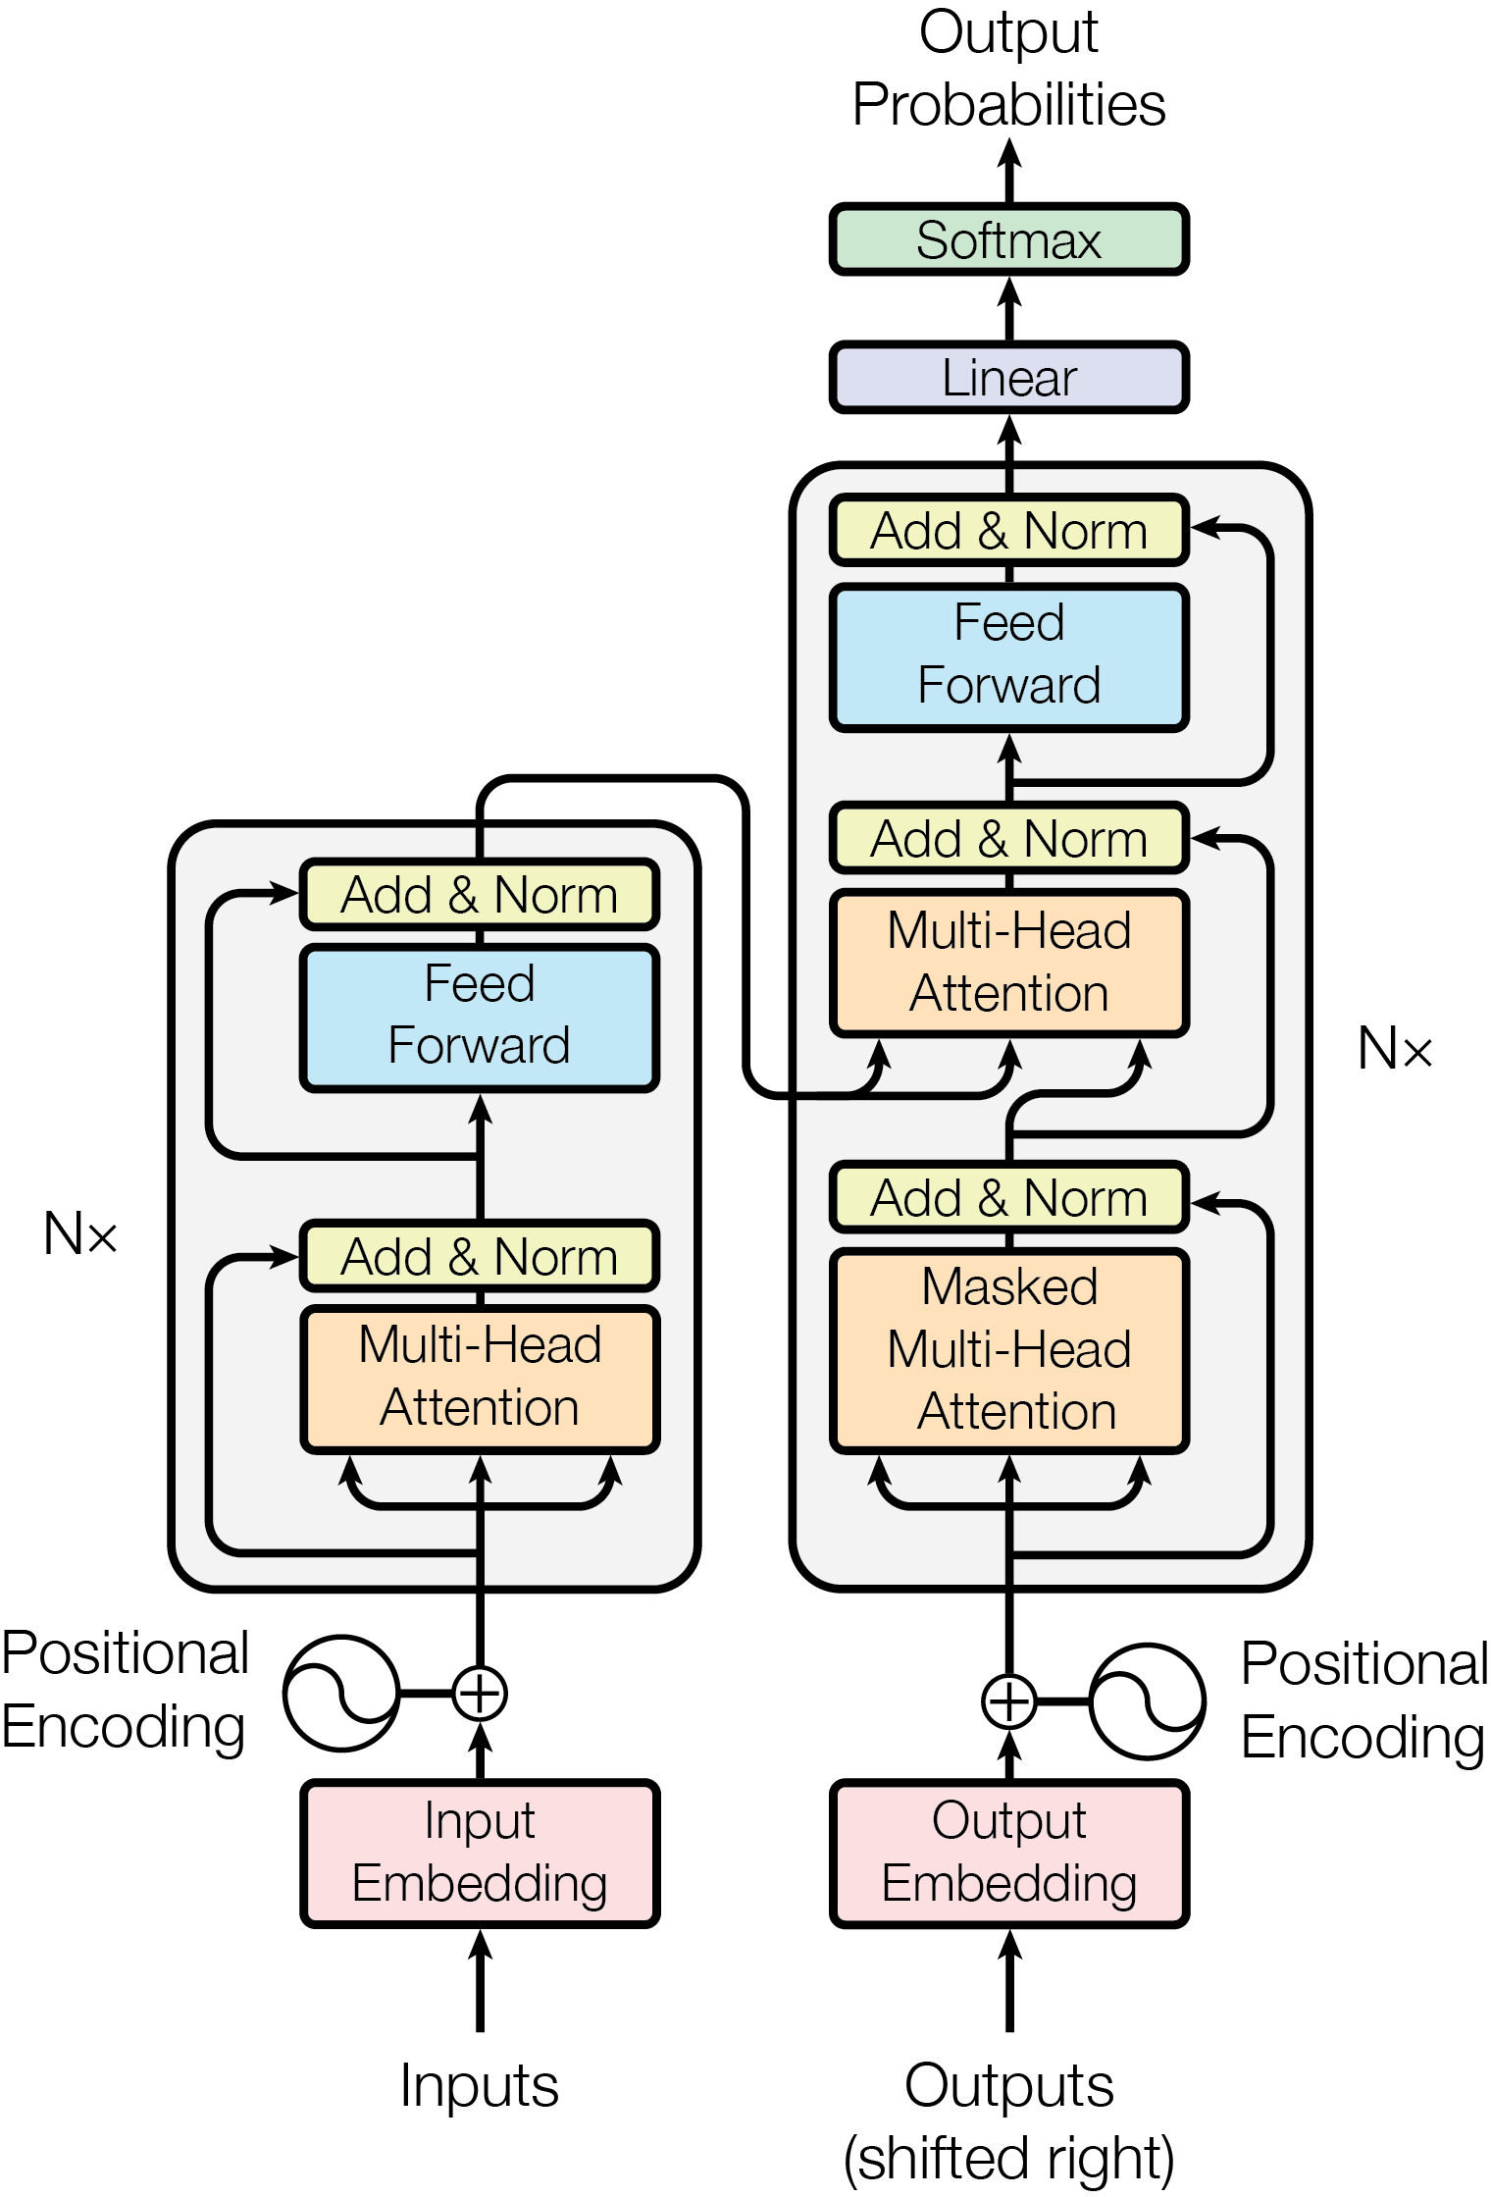

Attention is All You Need

Slide 28
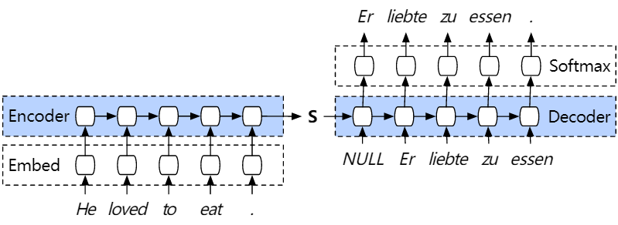
Encoder-Decoder
Machine Translation (Seq2Seq)

Slide 29
Transformer
Seq2Seq model
基于attention与dense layers构建
大规模数据集上性能超过RNNs
Encoders
Decoders

Slide 30
Transformer
Encoder
3. Feed Forward Networks
2. Multi-Head Attention
1. Input

Slide 31
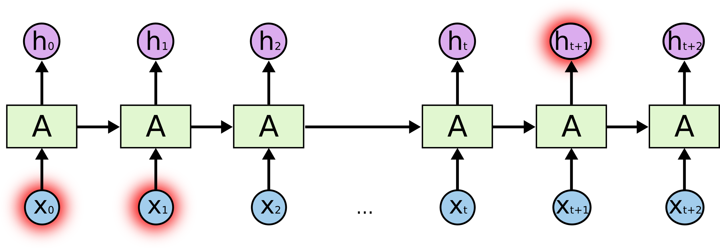
Input
Position Embedding
RNN

Slide 32
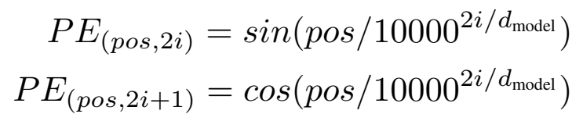
Input
Position Embedding

Slide 33
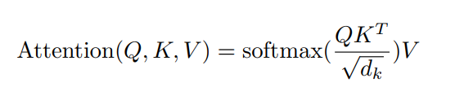

Single-head self-attention
Key, Value and Query ($K, V, Q$)
What is the baby doing?

Slide 34
Single-head self-attention
Top
left
Top
right
Bottom left
Bottom right
What is the baby doing?
Baby
Key1
Key2
Key3
Key4
Attention
Value
Query
Value1
Value2
Value3
Value4
V1
V2
V3
V4

Slide 35


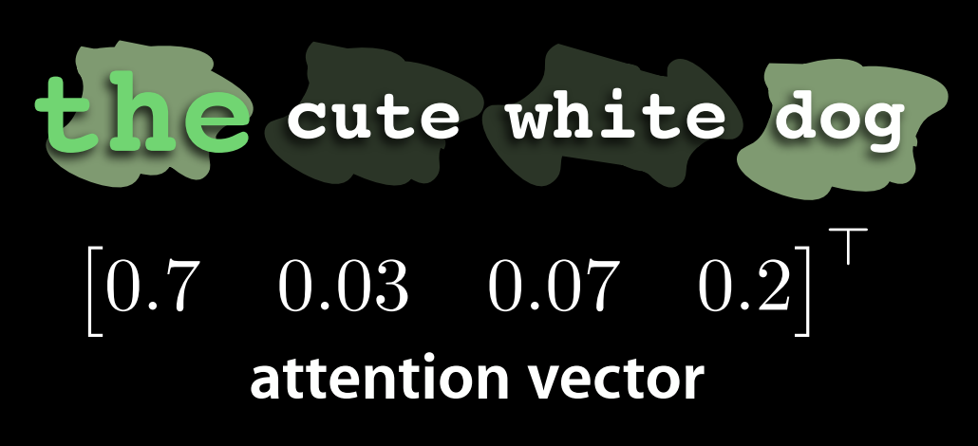


Single-head self-attention
计算每一个Token与其他Token之间的关联性(Attention)

Slide 36

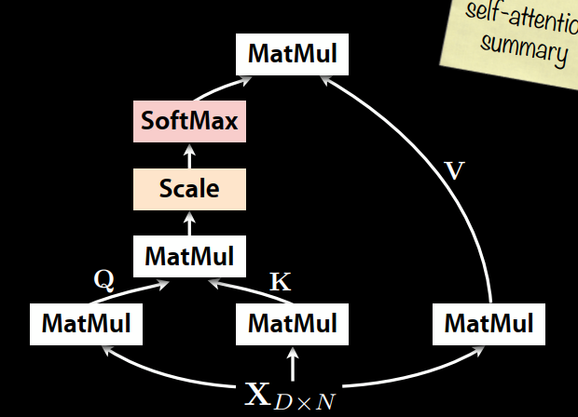
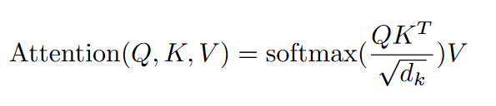
Single-head self-attention

Slide 37











Single-head self-attention
Key1
Key2
Key3
Key4
Query
$$F(Q,K)$$
$$F(Q,K)$$
$$F(Q,K)$$
$$F(Q,K)$$
S1
S2
S3
S4
Softmax
A1
A2
A3
A4
Attention
Value
$$∗$$
$$∗$$
$$∗$$
$$∗$$
$$+$$
$$+$$
$$+$$
Value1
Value1
Value1
Value1

Slide 38
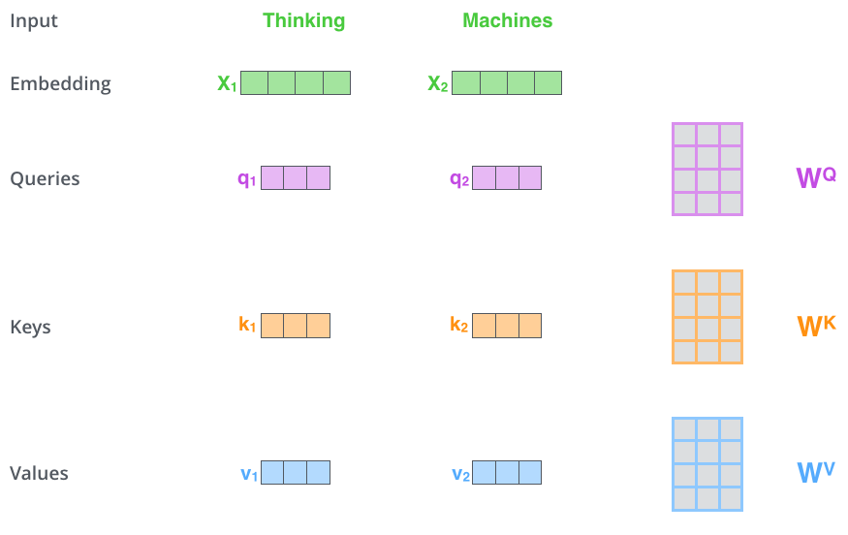
Single-head self-attention

Slide 39
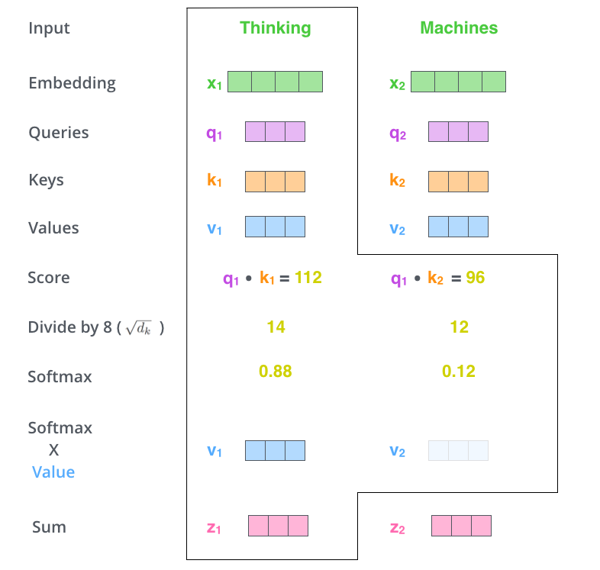
Single-head self-attention

Slide 40
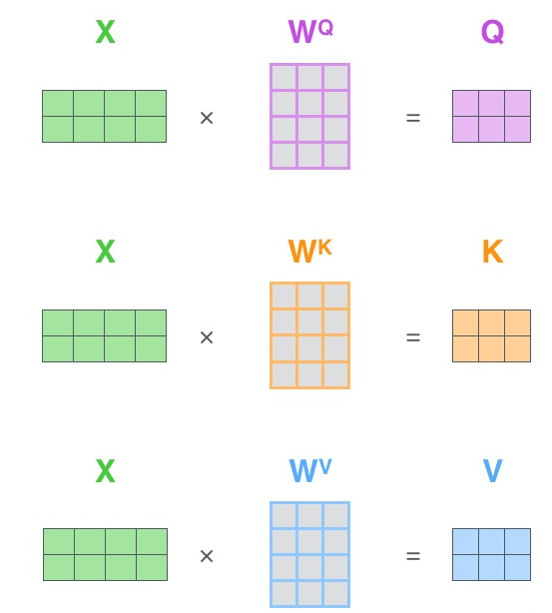
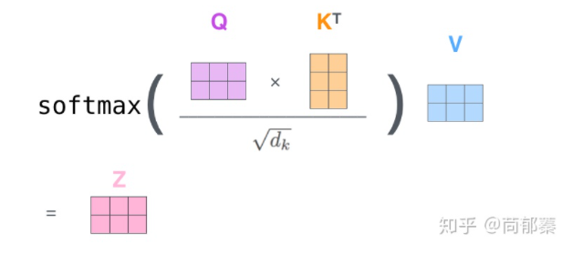
Single-head self-attention

Slide 41
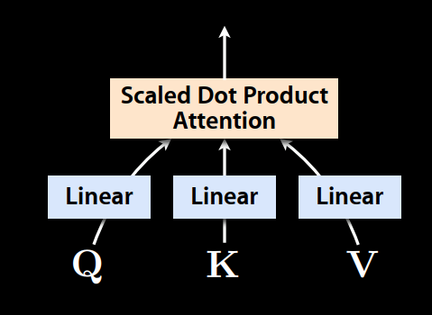
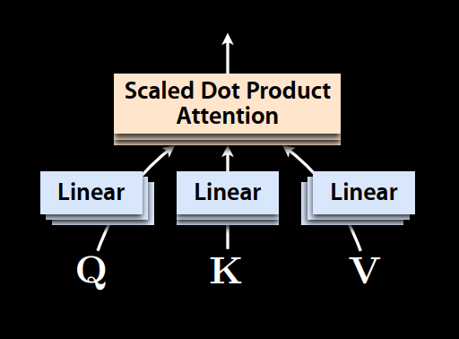
Multi-head self-attention
通过多组不同的权重计算得到多个Attention
Single-Head
Multi-Head

Slide 42
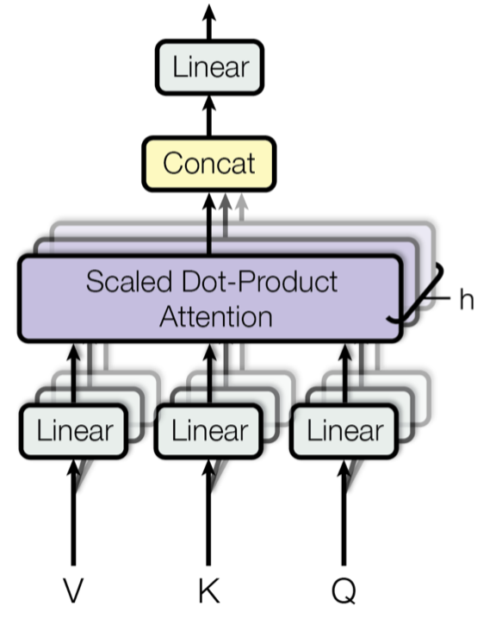
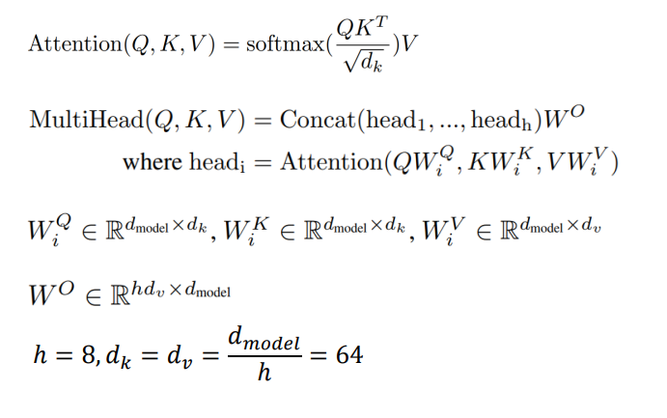
Multi-head self-attention

Slide 43
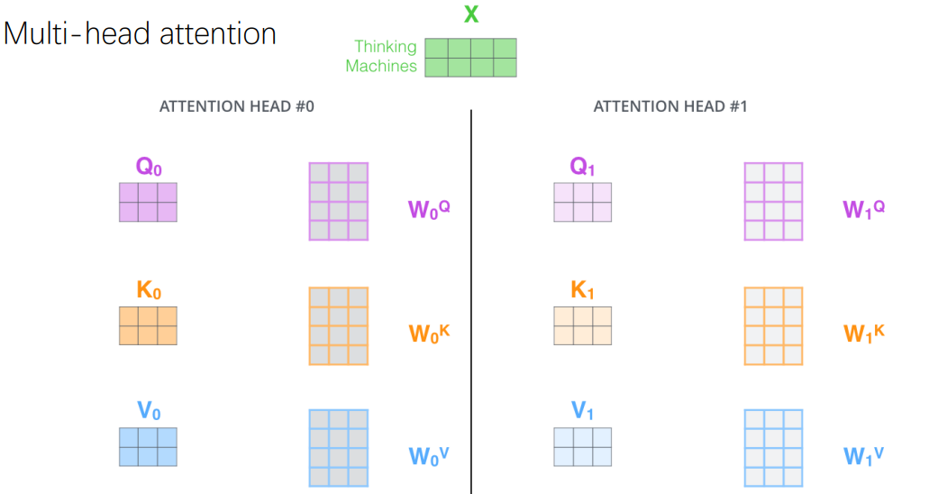
Multi-head self-attention

Slide 44

Multi-head self-attention (PyTorch)

Slide 45

Layer Normalization

Slide 46
Transformer Encoder
encoder_layer = nn.TransformerEncoderLayer(d_model=512, nhead=8)
transformer_encoder = nn.TransformerEncoder(encoder_layer,
num_layers=6)

Slide 47
Vision Transformer (ViT)
Dosovitskiy et al. An image is worth 16×16 words: transformers for image recognition at scale. In ICLR, 2021

Slide 48

Vision Transformer (ViT)
Dosovitskiy et al. An image is worth 16×16 words: transformers for image recognition at scale. In ICLR, 2021

Slide 49









Vision Transformer (ViT)

Slide 50











Vision Transformer (ViT)
Vectorization
Convert the patches of size $c×w×h$ to the vectors with size $cwh×1$
$$x_{1}$$
$$x_{2}$$
$$x_{3}$$
$$x_{4}$$
$$x_{5}$$
$$x_{6}$$
$$x_{7}$$
$$x_{8}$$
$$x_{9}$$

Slide 51











Vision Transformer (ViT)
Patch Embeddings
$$x_{1}$$
$$x_{2}$$
$$x_{3}$$
$$x_{4}$$
$$x_{5}$$
$$x_{6}$$
$$x_{7}$$
$$x_{8}$$
$$x_{9}$$
Dense
$$z_{1}=Wx_{1}+b$$

Slide 52



















Vision Transformer (ViT)
Patch Embeddings
$$x_{1}$$
$$x_{2}$$
$$x_{3}$$
$$x_{4}$$
$$x_{5}$$
$$x_{6}$$
$$x_{7}$$
$$x_{8}$$
$$x_{9}$$
$$W, b$$
Dense
Dense
Dense
Dense
Dense
Dense
Dense
Dense
Dense
$$z_{1}$$
$$z_{2}$$
$$z_{3}$$
$$z_{4}$$
$$z_{5}$$
$$z_{6}$$
$$z_{7}$$
$$z_{8}$$
$$z_{9}$$

Slide 53
Vision Transformer (ViT)
为什么要使用position embedding?

Slide 54





















Vision Transformer (ViT)
$$x_{1}$$
$$x_{2}$$
$$x_{3}$$
$$⋯$$
$$x_{n}$$
$$W, b$$
Dense
Dense
Dense
$$⋯$$
Dense
$$z_{1}$$
$$z_{2}$$
$$z_{3}$$
$$⋯$$
$$z_{n}$$
$$1$$
$$2$$
$$3$$
$$n$$
Position
Embedding
$$⋯$$

Slide 55



Vision Transformer (ViT)
Position Embedding

Slide 56

















Vision Transformer (ViT)
Extra class token用于最后的图像分类
$$x_{1}$$
$$x_{2}$$
$$x_{3}$$
$$⋯$$
$$x_{n}$$
$$[CLS]$$
Dense
Dense
Dense
Dense
$$⋯$$
Dense
$$z_{0}$$
$$+$$
$$z_{1}$$
$$+$$
$$z_{2}$$
$$+$$
$$z_{3}$$
$$⋯$$
$$+$$
$$z_{n}$$

Slide 57























Vision Transformer (ViT)
$$x_{1}$$
$$x_{2}$$
$$x_{3}$$
$$⋯$$
$$x_{n}$$
$$[CLS]$$
Dense
Dense
Dense
Dense
$$⋯$$
Dense
$$⋯$$
$$z_{0}$$
$$+$$
$$z_{1}$$
$$+$$
$$z_{2}$$
$$+$$
$$z_{3}$$
$$+$$
$$z_{n}$$
Transformer Encoder Network
$$c_{0}$$
$$c_{1}$$
$$c_{2}$$
$$c_{3}$$
$$⋯$$
$$c_{3}$$

Slide 58
























Vision Transformer (ViT)
$$x_{1}$$
$$x_{2}$$
$$x_{3}$$
$$⋯$$
$$x_{n}$$
$$[CLS]$$
Dense
Dense
Dense
Dense
$$⋯$$
Dense
$$⋯$$
$$z_{0}$$
$$+$$
$$z_{1}$$
$$+$$
$$z_{2}$$
$$+$$
$$z_{3}$$
$$+$$
$$z_{n}$$
Softmax
Classifier
$$P$$
Transformer Encoder Network
$$c_{0}$$
$$c_{1}$$
$$c_{2}$$
$$c_{3}$$
$$⋯$$
$$c_{3}$$

Slide 59


ViT (PyTorch Implementation)
https://uvadlc-notebooks.readthedocs.io/en/latest/tutorial_notebooks/tutorial15/Vision_Transformer.html

Slide 60
Image Classification Accuracies
只在ImageNet数据集上性能不如Resnet
更大规模的数据集上性能会提升
比更大的CNNs模型的性能更优

Slide 61

Image Classification Accuracies
更大规模的数据集上ViT的性能优于ResNet

Slide 62

Object Detection
给定一张输入图片，预测一组Bounding boxes

Slide 63

Detection Transformer (DETR)
Set prediction formulation
No geometric priors (NMS, anchors, …)
Fully differentiable
Competitive performance

Slide 64

Detection Transformer (DETR)

Slide 65



Detection Transformer (DETR)
Bipartite matching
Loss function

Slide 66

Experimental Results

